Slide 1
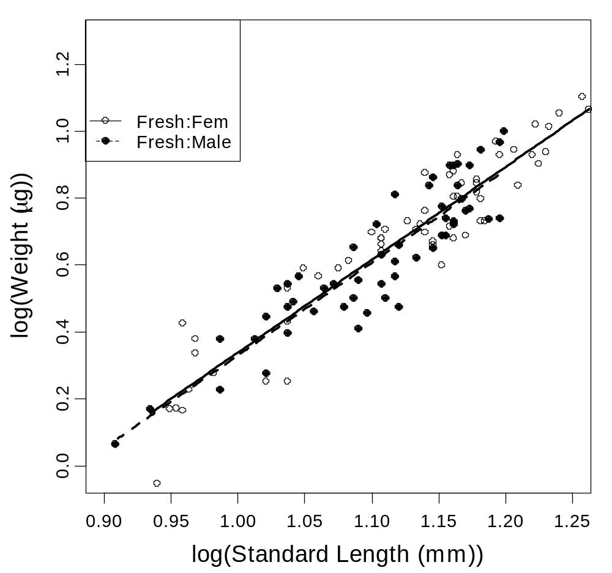
Adult, Non-Gravid Males & Females

Slide 2
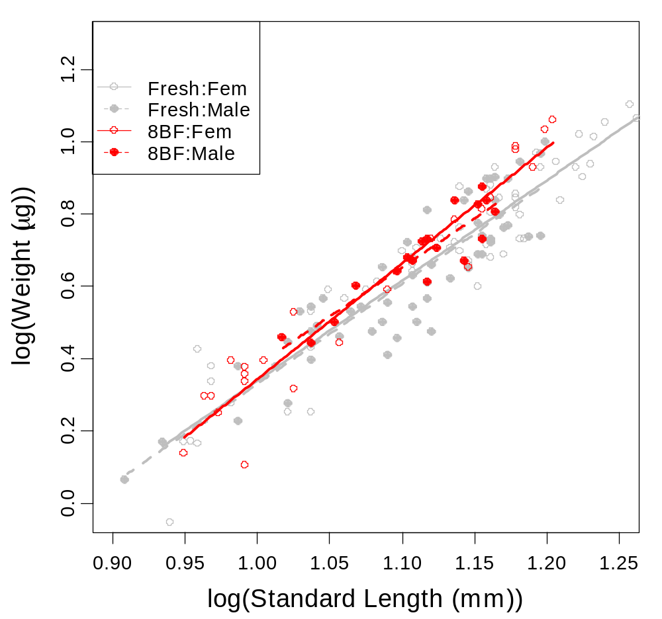
Adult, Non-Gravid Males & Females

Slide 3
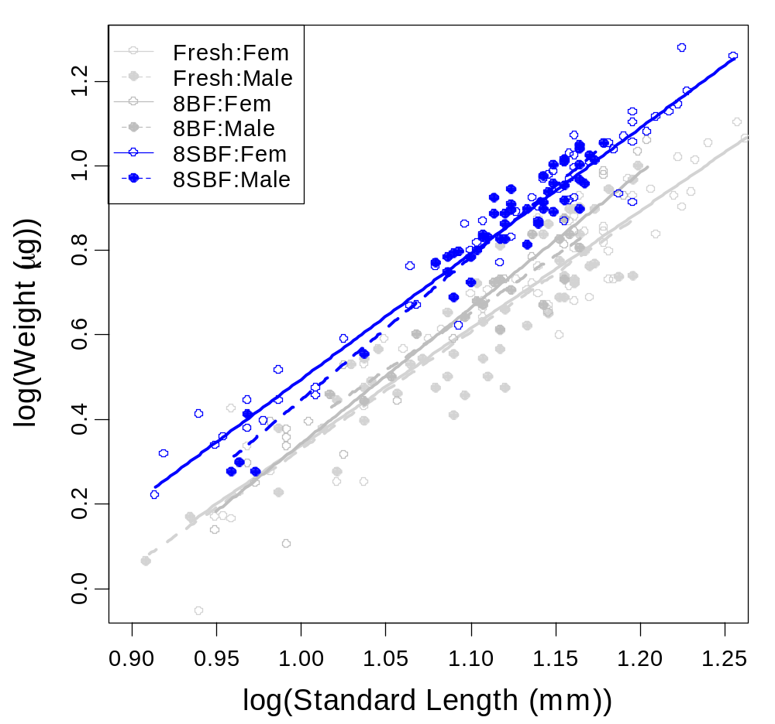
Adult, Non-Gravid Males & Females

Slide 4
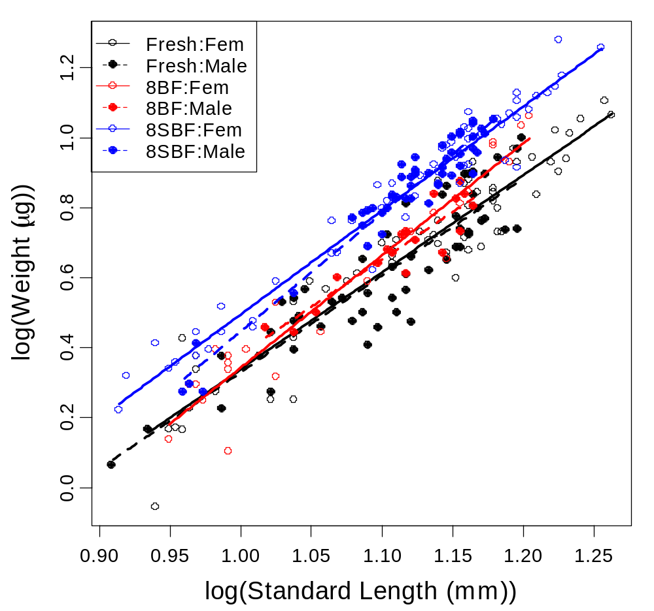
Adult, Non-Gravid Males & Females

Slide 5
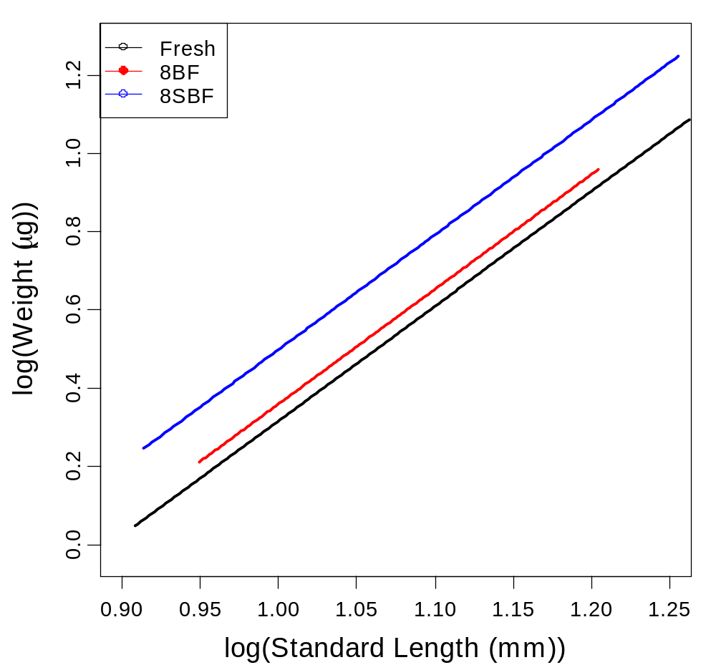
Adult, Non-Gravid Males & Females

Slide 6
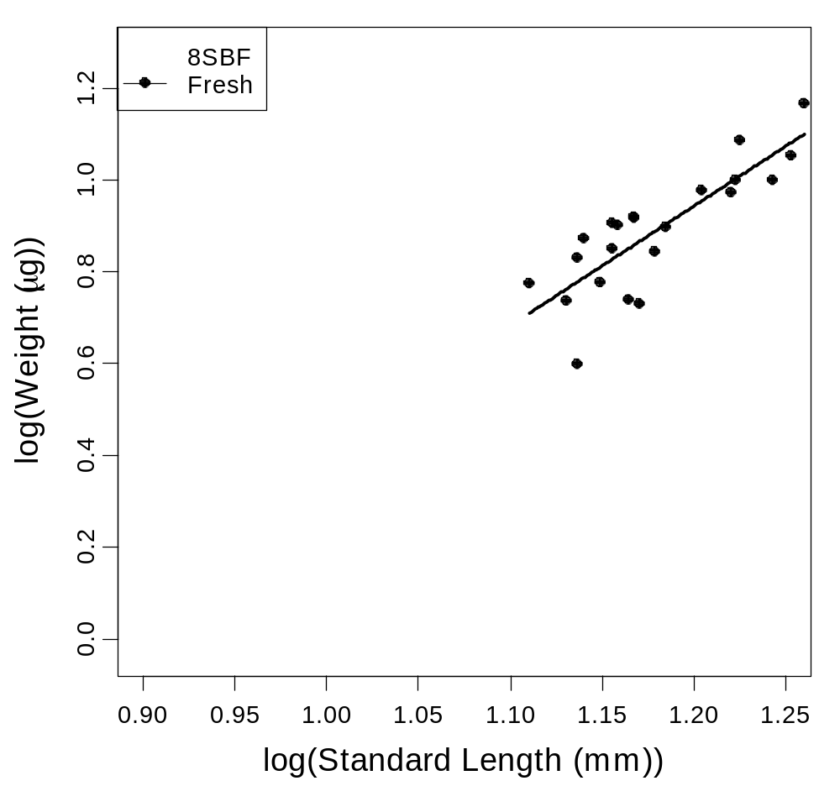
Adult, Gravid Females

Slide 7
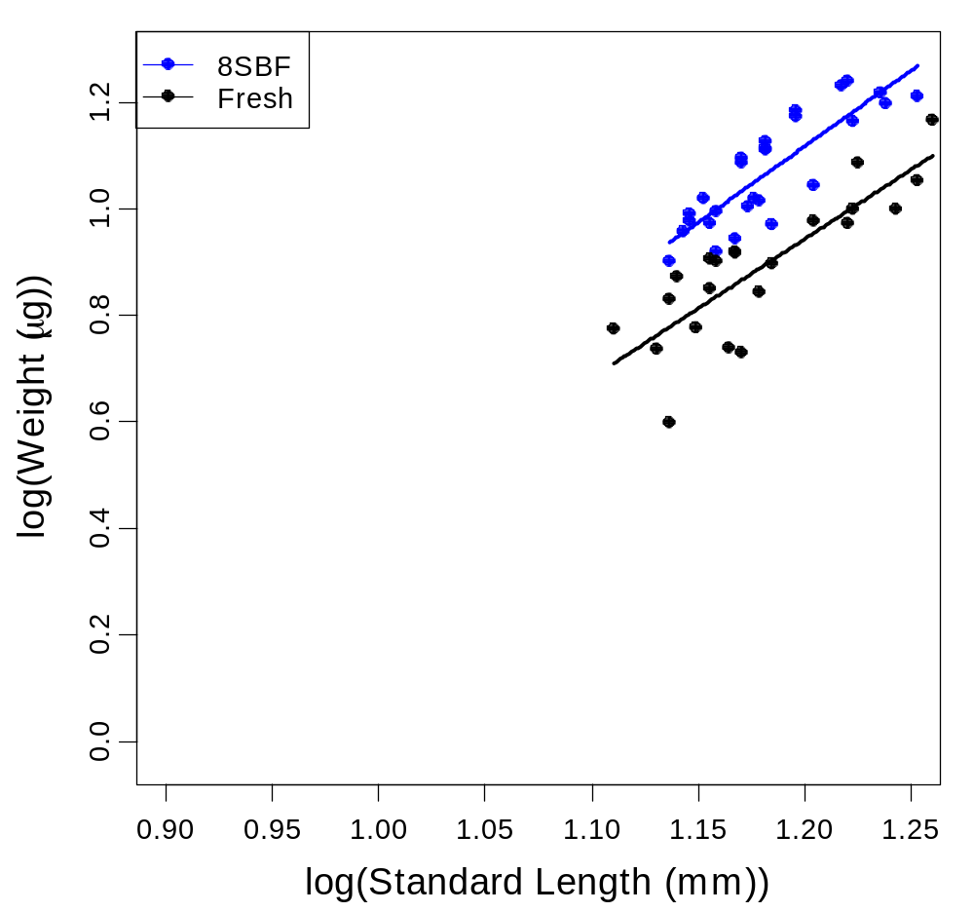
Adult, Gravid Females

Slide 8
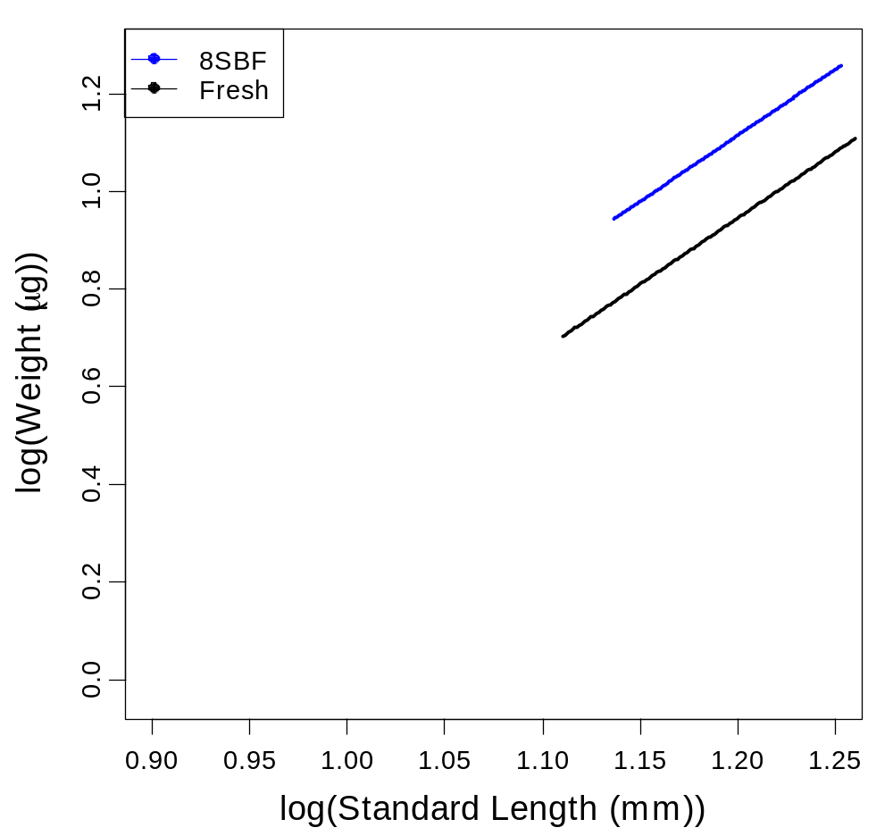
Adult, Gravid Females

Slide 9
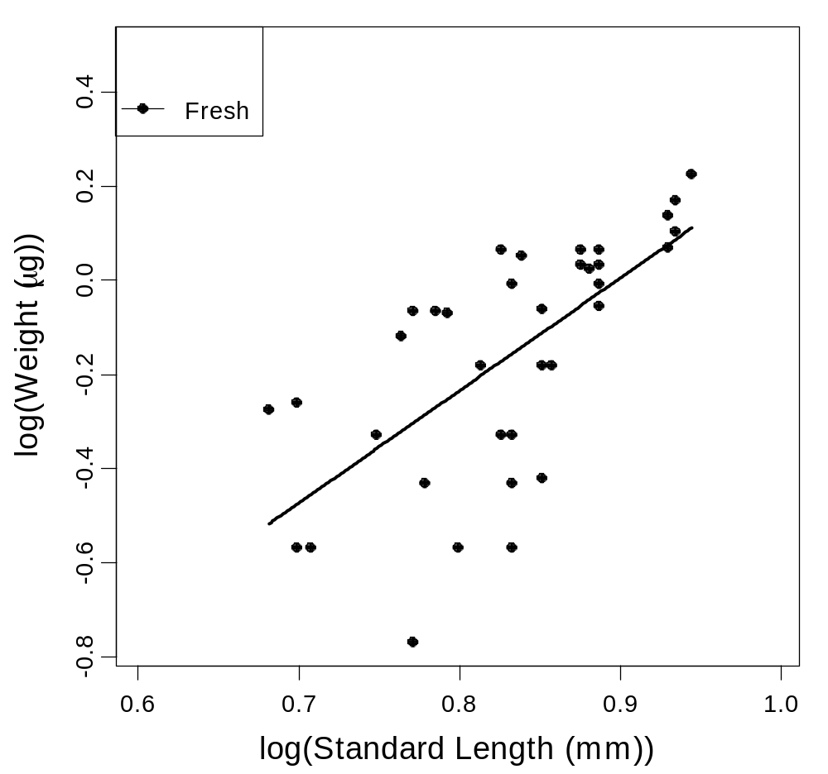
Juveniles

Slide 10
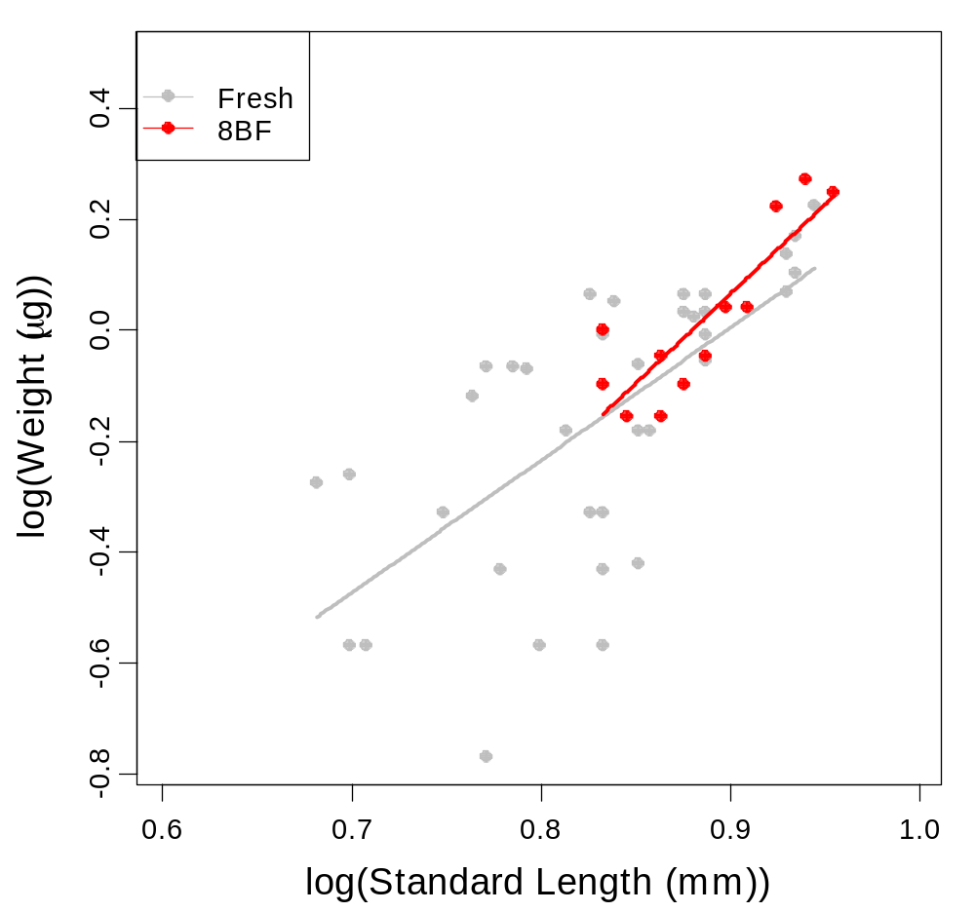
Juveniles

Slide 11
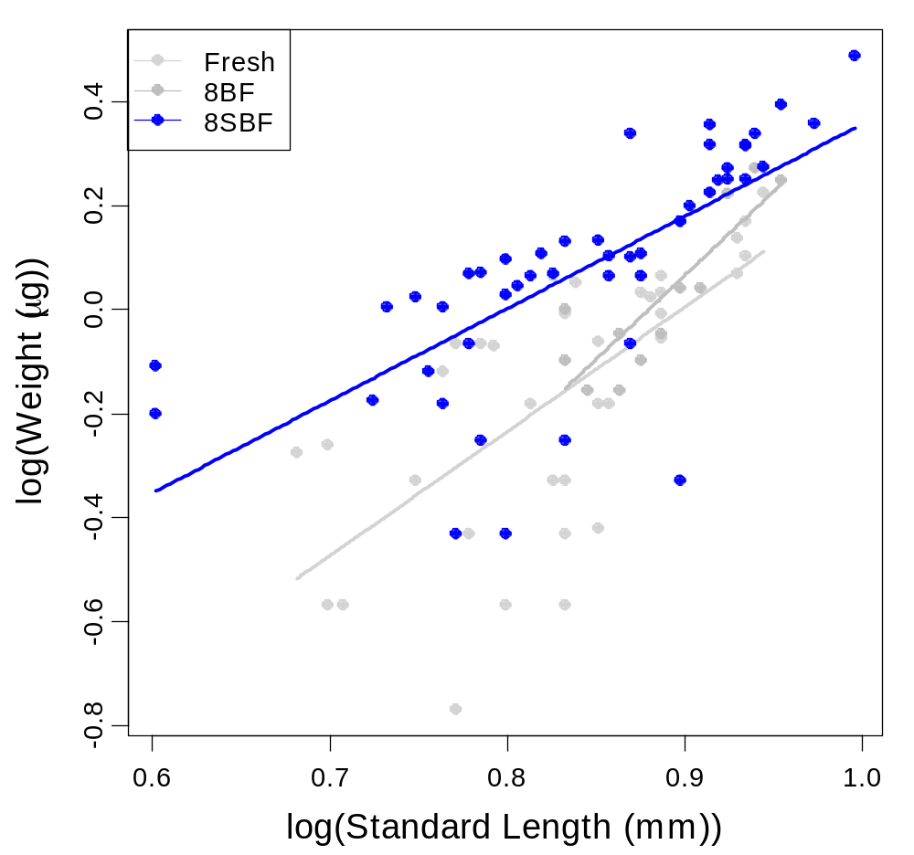
Juveniles

Slide 12
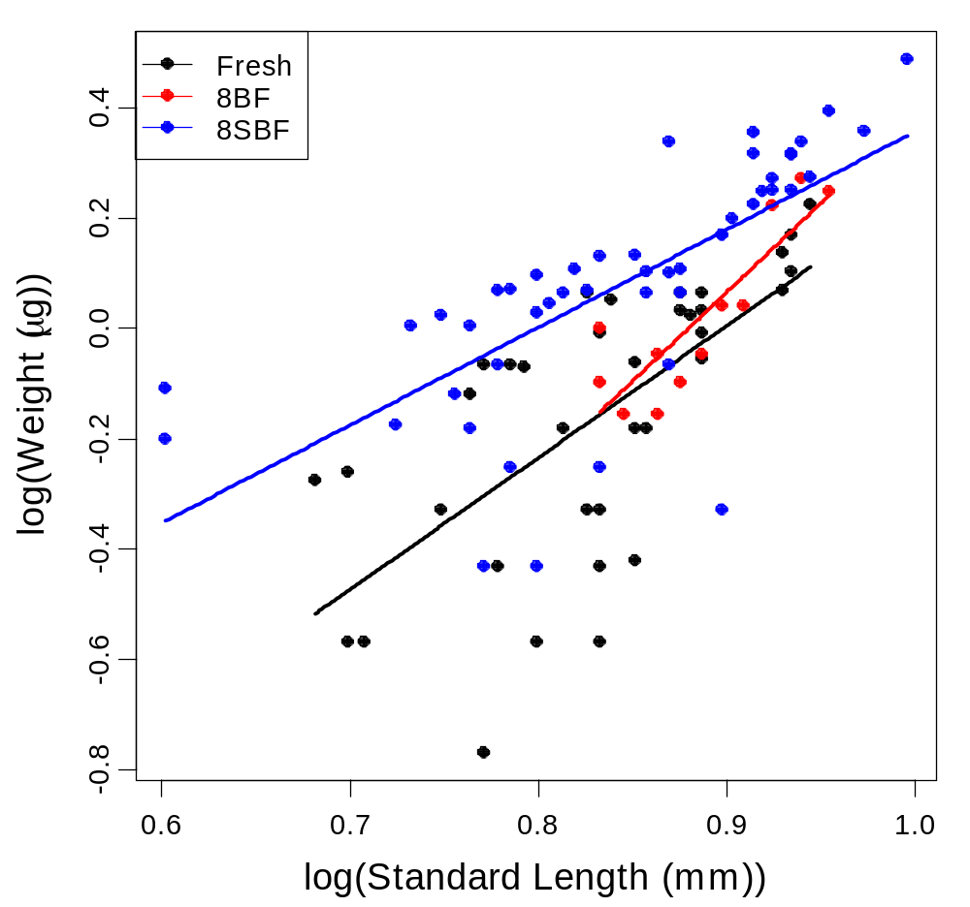
Juveniles

Slide 13
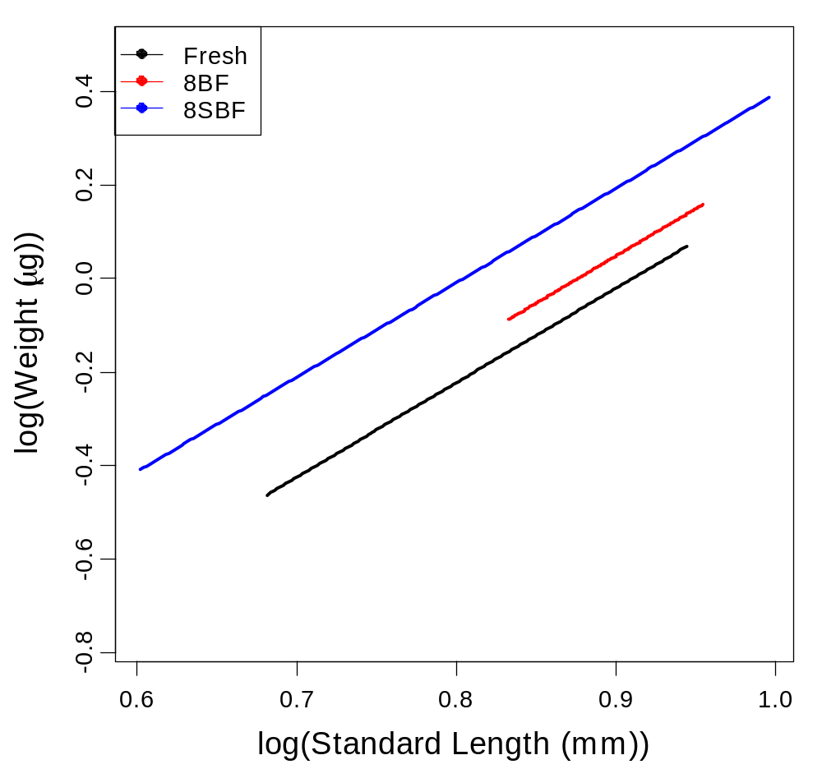
Juveniles

